Slide 1




Medical Center Health System
Patient Safety Event Reporting:
Medical Center Hospital System is committed to improving the quality and safety of patient care through:
Identification and evaluation of errors, near misses or hazardous/unsafe conditions that are a threat to patient safety or have the potential to result in patient harm.
Knowing about adverse events and potential adverse events enables the hospital to analyze the events and put processes in place to prevent similar events from happening in the future.
To foster a culture of safety and learning across the organization by openly discussing patient safety at all levels.
MCHS uses an on-line tool that we call Patient Safety Event Reporting System. This is an on-line reporting tool that allows you to select the type of an event and guides you through the event identification process.
On the MCH home screen, click on Patient Safety Event shortcut and you will be taken to a screen with multiple icons, click on the icon which is the most appropriate, and enter the information about your report. You also may submit a Patient Safety Event through one of the following areas (all will give you an option to report Anonymously).
• QR Code
https://medicalcenter.performancehealth.app/solutions/incident-reporting
MCHS Intranet Page - “Report a Patient Safety Event”
Desktop shortcut Icon -
PowerChart shortcut- “Report Patient Safety Event”
A short “how to report” video can be accessed below:
https://www.loom.com/share/ddc03ff2085644bf8aae86bc4ab1a93a
Why should you report patient safety events?
Reporting is essential to the identification and evaluation of errors for the purpose of identifying root causes and trends which leads to improving processes which is essential to reduce risk and prevent patient harm. All team members are required to participate in the detection and reporting of any error, medication error, near miss, hazardous/unsafe condition, process failure, injuries involving patients, visitors and staff or a sentinel event.
What you should report when entering a patient safety report:
Any happening not consistent with routine patient care
Any event not consistent with normal operations
Any event that causes patient harm, or has the potential to cause harm
A good catch or near miss- an event if it did occur had the potential to cause harm
Patient complaints and grievances
Patient Safety Event Tips/Reminders:
Enter as soon possible, so critical information is not forgotten (with-in 24 hours)
Do not make copies of the Patient Safety Event
Do not document in a chart that a Patient Safety Event was submitted or request to submit a Patient Safety Event
Do not point fingers at other people or departments, avoid hearsay, enter what you see
Only report the facts
Ensure patient safety- after any event that has occurred or hazardous condition has been identified, first and foremost staff should ensure the safety of the patient and notify the charge nurse and physician as appropriate.
If a patient or patient’s representative threatens to get a LAWYER- DO NOT PANIC!
Do Not engage in a conversation regarding their statement or the appropriateness of their concerns
Contact Risk Management
Continue to provide care

Slide 2

Examples of reportable events:
Adverse Event – a patient safety event that resulted in harm to a patient.
No-harm event- a patient safety event that reaches the patient but does not cause harm. Near miss event (or “good catch”) – a patient safety event that did not touch the patient.
Hazardous condition (or unsafe condition)- a circumstance, other that the patient’s own disease process or condition, that increases the probability of an adverse event.
A sentinel event is a patient safety event (not primarily related to the natural course of the patient’s illness or underlying condition) that reaches a patient and results in any of the following:
  Unexpected Death
  Permanent Harm
  Severe temporary harm – A critical, potentially life-threatening harm lasting for a limited time with no permanent residual but requires transfer to a higher level of care/monitoring for a prolonged period of time, transfer to a higher level of care for a life-threatening condition, or additional major surgery, procedure, or treatment to resolve the condition.
  Unanticipated death of a full-term infant.
  Patient Suicide. (State Mandated)
  An elopement that leads to a patient death or permanent harm.
  Hemolytic transfusion reaction involving administration of blood or blood products having major blood group incompatibilities (ABO, Rh, other blood groups).
  Invasive procedure, including surgery, on the wrong patient, at the wrong site, or that is the wrong (unintended) procedure.
  Assault or rape.
  Unintended retention of a foreign object in a patient after an invasive procedure, including surgery.
  Any intrapartum (related to the birth process) maternal death.
  Severe maternal morbidity (not primarily relates to the natural course of the patient’s illness or underlying condition) when it reaches a patient and results in permanent harm or severe temporary harm.
All Falls
All AMA’s
Employee or other Staff Injuries
Diagnosis or treatment errors
**Medication errors, adverse drug events
**All new, new staged 3 and 4, and all unstageable pressure ulcers acquired after admission/presentation
Surgical site infections
Equipment patient injuries
Patient injury associated with the use of contaminated drugs
Lost Specimens
Diagnostic events leading to delay of care (lab, Radiology, Respiratory)
ID/Documentation/Consents (wrong MRN, incorrect consent)
Infection Control Issues
Environment
Patient Complaints/Grievances
Deviation from policy/protocol (education/training)
Lost Items such as: glasses, dentures, hearing aides (see policy MCH-4031) use yellow bags/label bags
Other reportable events
Review the following policies to learn more about patient safety and reporting:
Patient Safety Event Reporting System Policy MCH-4012
Personal Injury Occurrence and Emergency Care Policy MCH- 4029
NON-Punitive Reporting Policy MCH-4046
Chain of Command Issue Resolution Policy MCH- 1071
Sentinel Event/Patient Safety Event Policy MCH-4024
Safe Medical Device Act MCH-4025
Patient Complaint and Grievances MCH-2049
** Call 640-2293)
Contact Risk Management, Mary Gallegos at 432-640- 2487 or by email at mgallegos1@echd.org

Slide 3
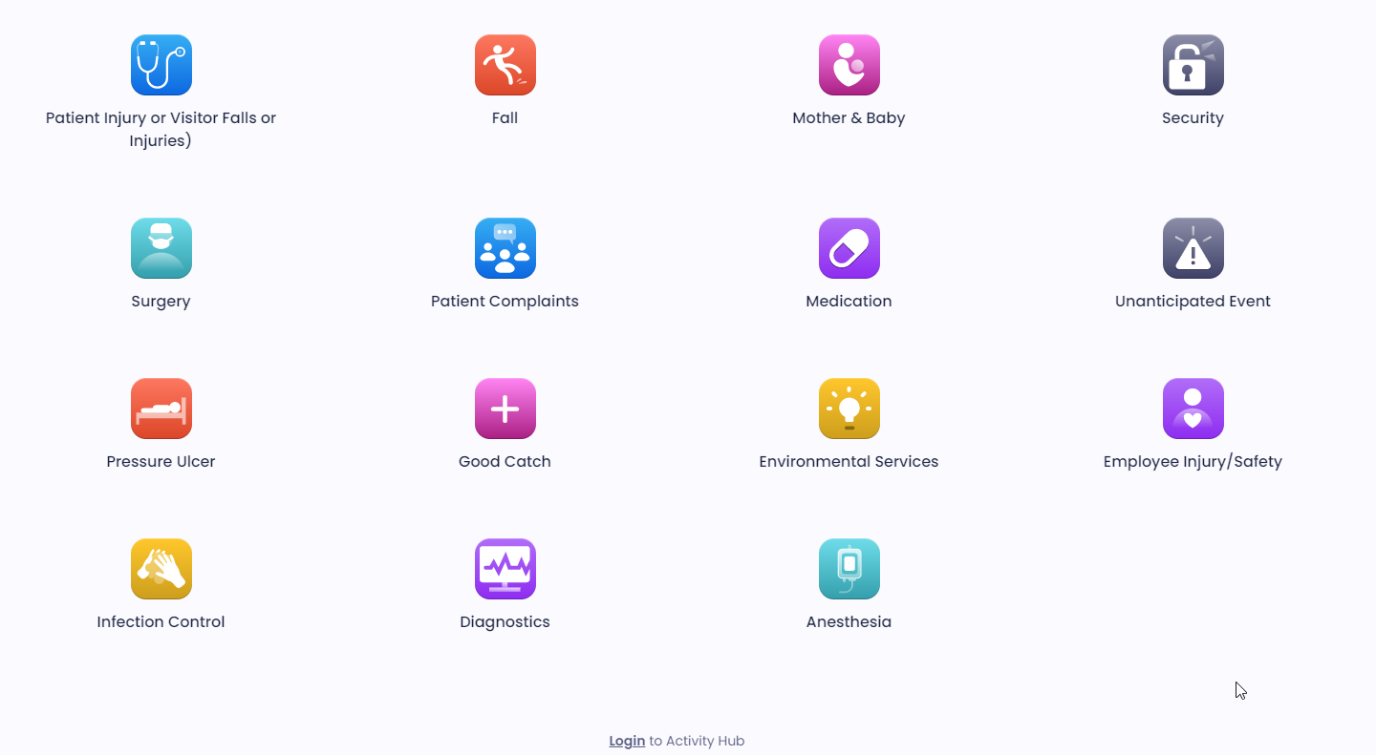
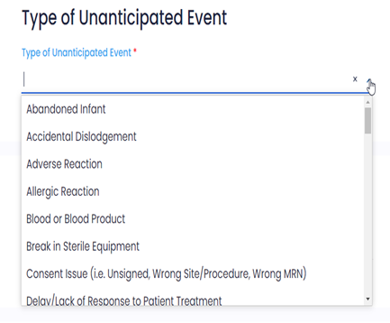
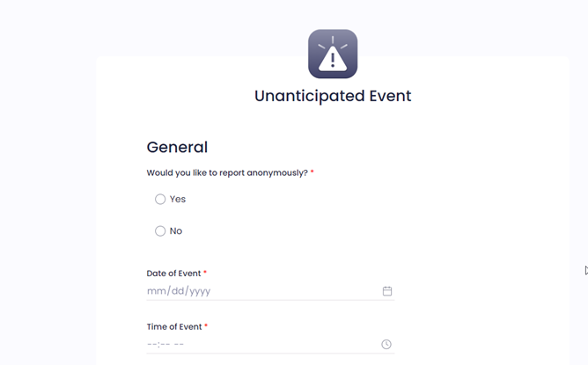
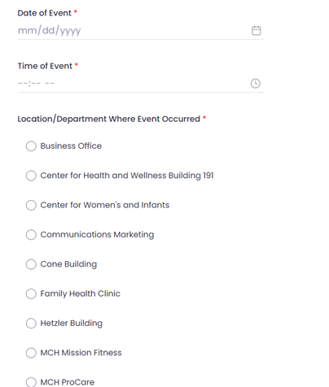
Patient Event Reporting System (screen shots on how to use)
Select Event Type from drop down menu
Employee Injuries
Step 1- Enter Date/Time of Event
Step 2-
Select
Facility

Slide 4
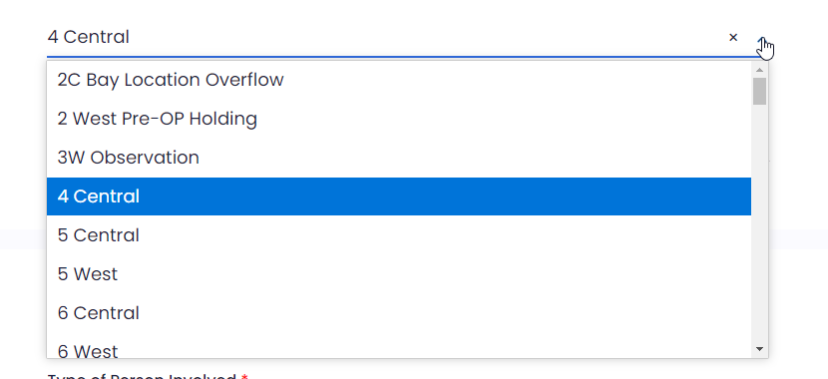
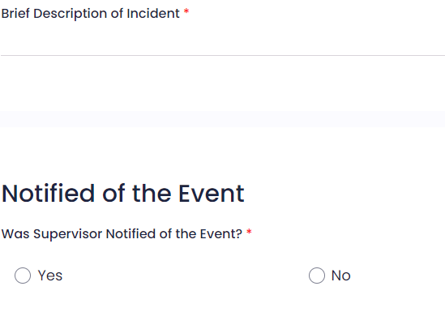
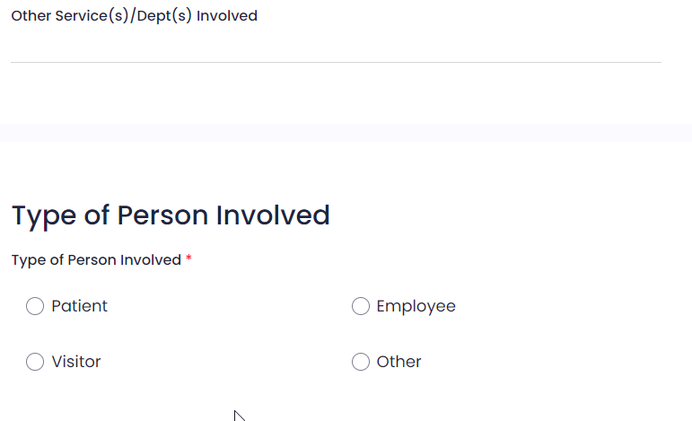
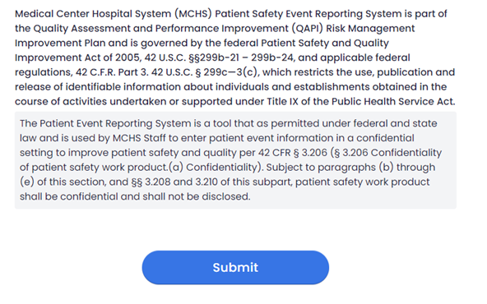
Step 5 enter description
Step 3- select
Department
6- If yes, a window will open
To enter name/title
Enter if another department
was involved with the event
Step 4
Know: Patient First & Last Name
DOB, Gender, & FIN
Know Visitor: First & Last Name, & Phone Number
Click Submit

Slide 5
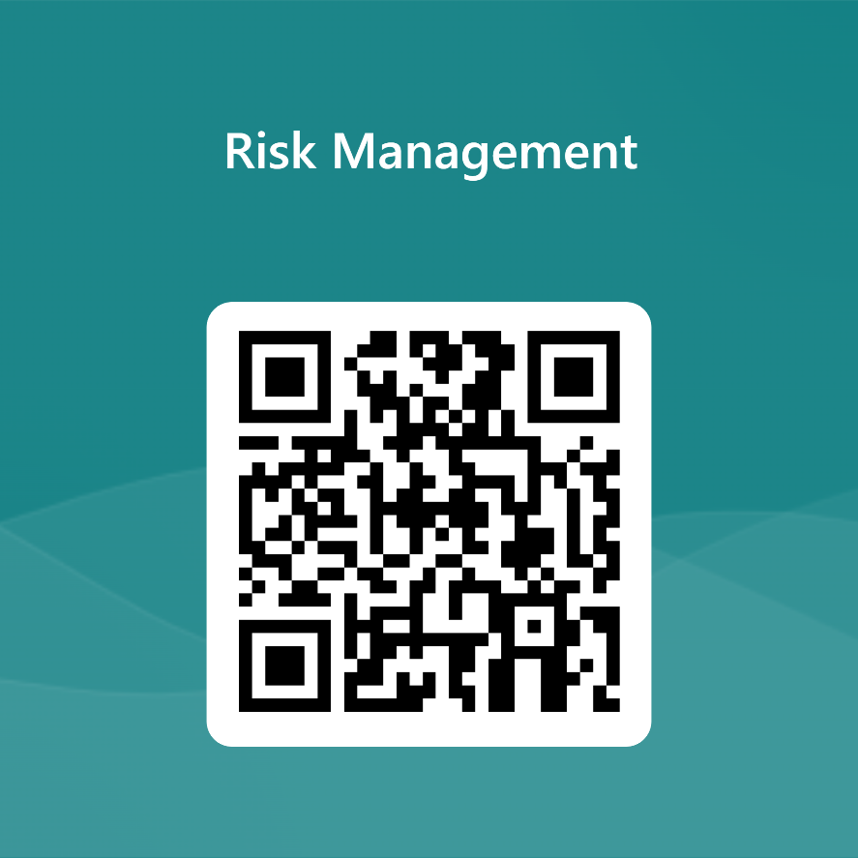
Continue to Test
Link
QR Code
https://forms.office.com/r/MdvegPBhCh

